Slide 1
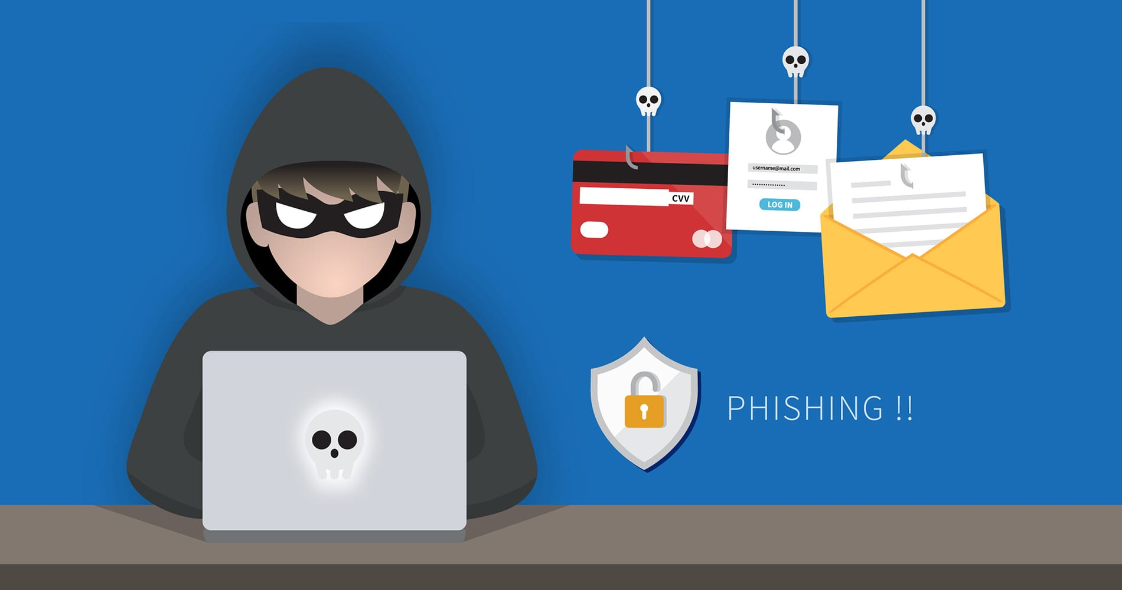
PROTECTING YOURSELF FROM PHISHING ATTACKS

Slide 2
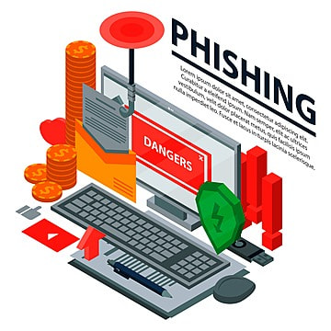
INtroduction
Understanding phishing
Define phishing: A cyber attack that uses disguised emails, websites, or messages to trick individuals into revealing sensitive information.
Importance of phishing awareness in protecting personal and organizational data.

Slide 3

Types Of Phishing Attacks
Common Types of Phishing
Email Phishing: Fake emails that appear to be from a legitimate source.
Spear Phishing: Targeted attacks aimed at specific individuals.
Whaling: High-profile attacks targeting executives or high-level employees.
Vishing and Smishing: Voice and text phishing attacks.

Slide 4
Anatomy of a Phishing Email
Recognizing Phishing Emails-
Sender Address: Check for inconsistencies or misspellings in the sender’s email address.
Subject Line: Look for urgency, threats, or offers too good to be true.
Email Content: Notice poor grammar, generic greetings, and suspicious links or attachments.
Call to Action:* Be wary of requests for personal information, urgent actions, or link clicks.

Slide 5
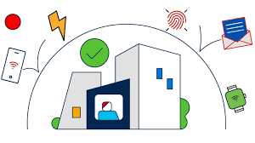
Phishing Websites
Identifying Phishing Websites-
URL Check: Ensure the URL is legitimate and matches the website you expect.
SSL Certificate: Look for the padlock symbol indicating a secure connection. Content Review: Look for mismatched branding, poor design, and spelling errors.
Avoidance Tips: Never enter personal information on suspicious sites; use bookmarks for frequently visited sites.

Slide 6
Social Engineering Exploits
1. Attackers posing as trusted individuals : Promises of free goods or services to trick you into providing information.
2. Pretexting: Creating a fabricated scenario to extract personal details.
3. Tailgating: Physical security breach by following someone into a restricted area.

Slide 7
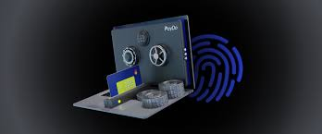
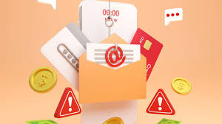
Real-Life ExamplesTitle
Example 1: A successful email phishing attack and its consequences.
Example 2: How a spear-phishing attack targeted a specific organization.
Lesson Learned: Importance of vigilance and double-checking information.

Slide 8
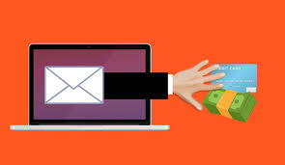
Protecting Yourself Phishing Prevention Techniques 1. Email Filtering: Enable spam filters to reduce phishing attempts 2. Two-Factor Authentication (2FA): Adds an extra layer of security 3. Password Management: Use strong, unique passwords for different accounts 4. Regular Updates: Keep software and systems up to date to prevent vulnerabilities

Slide 9
PHISHING
Phishing attacks will continue to happen in the future. It is up to the organization and its employees to learn from past mistakes and not repeat them.
Employees can educate themselves on how to stop phishing emails. Organizations can deploy the best phishing protection solutions to deal with such situations effectively.
Furthermore, organizations must include case studies related to past incidents in the employee education and training programs.

Slide 10

THANKS
want to express my gratitude for your time and active involvement in today's presentation, focusing on safeguarding against phishing attacks. Your engagement enhances our collective understanding and commitment to strengthening cybersecurity measures

